Slide 1


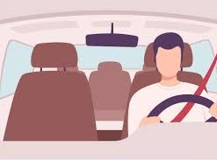
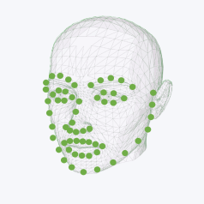

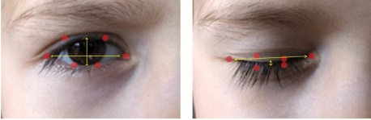
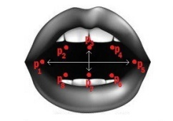
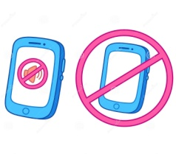

System
WebCam
Video Capturing
Dividing Video into Frames
Send Location of Driver
Facial Landmarks Extraction
Near ones of Driver
Is it a drowsy state?
Eye Closure Detection
Yawn Detection
Yes
Alarm turnoff by Driver Manually
Warning Alarm
No

